Slide 1
THE TRAVEL APPROVAL & EXPENSE REIMBURSMENT DATABASE AT STARK SEALING SOLUTIONS Phase II Presentation – Team Four – November 1, 2015

Slide 2

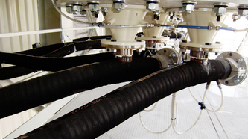

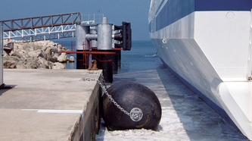
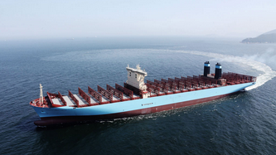
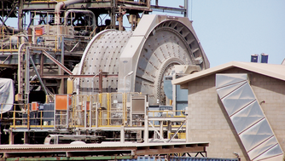




Recap – Stark Sealing solutions
Fast growing German company whose employees travel most of their time
Current process: Sequential, paper-based approach to request travel and file expense reports
Problem: The process takes to much time and threatens to affect customer and employee satisfaction
Plans for new process: Parallelized process with database as a backbone
The database design phase is completed!

Slide 3
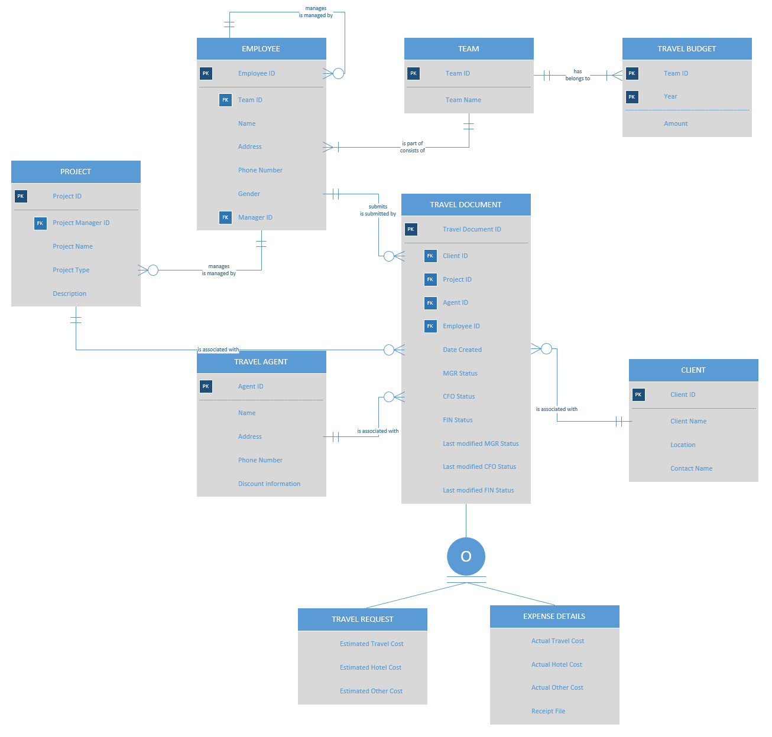
Entity Relationship Diagram

Slide 4
Related set of tables
Budget
TeamID | Year | Amount
Team
Project
ProjectID | Project Name | ProjectManagerID | Project Type | Description
TeamID | Team Name
Employee
EmployeeID | Name | Address | Phone Number | Email Address | Gender | ManagerID | TeamID
Travel Agent
AgentID | Name | Address | Phone Number | Discount Information
Travel Document
Client
TravelDocumentID | EmployeeID | Date Created | ClientID | ProjectID | AgentID | Description | MGM Status
CFO Status | FIN Status | Last Modified MGM Status | Last Modified CFO Status | Last Modified FIN Status
ClientID | Client Name | Location | Contract Name
Travel Request
Expense Details
TravelDocumentID | Travel Cost | Hotel Cost | Other Cost
TravelDocumentID | Actual Travel Cost | Actual Hotel Cost | Actual Other Cost | Receipt File

